Slide 1
To-do List Website

Slide 2
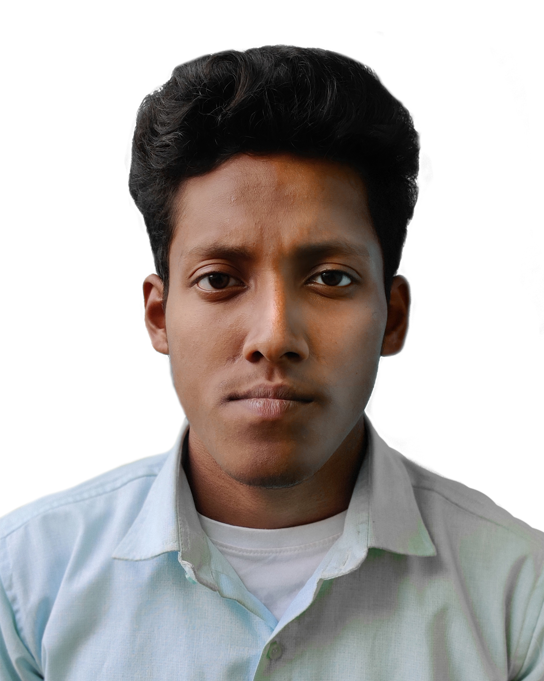

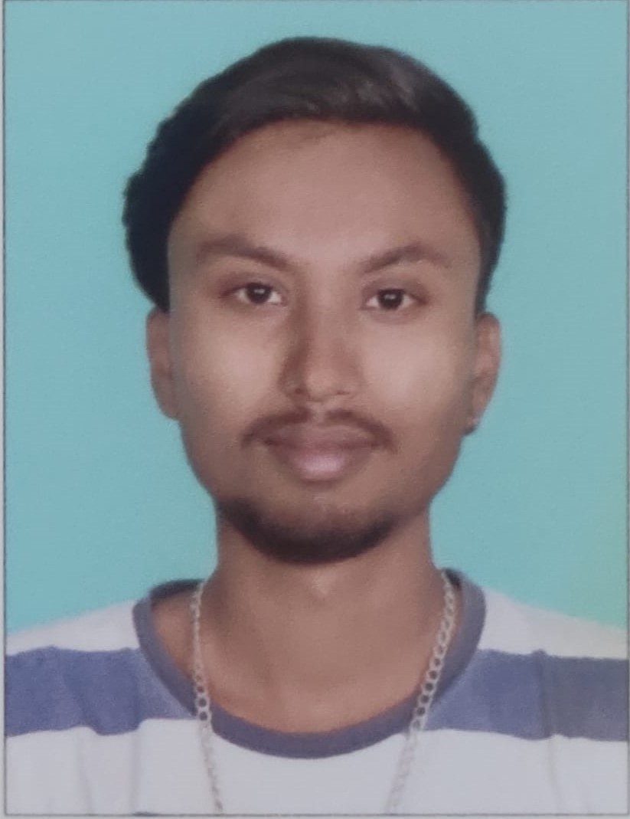
Team introduction
Application Developed By-
Suprakash Mandal 2) Aishwarya M 3) Gagan G

Slide 3
Introduction
TODO List are the lists that we generally use to maintain our day to day tasks or list of everything that we have to do. It is helpful in planning our daily schedules. We can add more tasks any time and delete a task which is completed also. We have build a portal for creating to-do list where user can signin and signup and view their respective todo as per their profile they can also add new todo and update and delete also user can mark the todo completed.

Slide 4
Objectives
Users can signin or signup.
Each user will have the ability to create tasks, add dates for targeted completion.
Each user will have the ability to mark tasks as completed, when marked as completed the task are crossed out.
Each task if not completed on time, will be displayed red in color.
User can filter the todo asper completed, not completed and all todo tasks.

Slide 5
Presentation layer
The presentation layer is the top layer of the spring boot architecture. It consists of Views. i.e., the front-end part of the application.
Signup :In sign up we have username and password and validations for password.
Signin: Validation of the username and password.
Home: It shows the username ,number of todo that is not completed out of total number of todos.
view todo: It has components like add todo ,update , delete, no of tasks added and mark the tasks which are completed and user can add todo and along with the target date.
Todo count-User can request how many todo to display in the view to do component.
Pagination: We have used Pagination concept in our project for moving among the pages with First Page, Second Page, Third Page, Fourth Page etc. Buttons or Links.
sign out: User can sign out.

Slide 6
Business logic layer
The business layer contains all the business logic. It consists of services classes. It is responsible for validation and authorization.
Sign-Up :It will take the user name and password. It validates password as we click on the signup button axios will call the signup API request along with the username and password. Using post method we are going to add to the todolist database in the user table and store the role as user. Signup API will give response which contain token and username. It will automatically logged in and redirect to the home page.
Signin: It will take the username and password and will validate username and password as we click on signin button it will call the signin API and matches with the existing username and password. If username and password is present and if it is matched it will give the response which contain username and token. It will set user as “isAuthenticated” true.
View todo: It will fetch all the data present in todo table in the database and mapped it into the view todo page table by calling view todo API. It has components like add ,update ,delete.
Add todo: It will take todo tittle and the target date and it will call the add todo API with the tittle and the target date data and will store it to the todo table along with the username. It will redirect to the view todo page.

Slide 7
Data layer
We have used Spring Boot JPA which allow us access and persist data between java object/class and relational database it automatically going to create tables as we define in the entity class .
We have used JPA Repository for accessing MySQL database and to perform all the curd operations.
Database name : todo list
Todo table: It contains id ,is_completed ,target_date ,tittle ,username columns.
User table : It contains id ,password ,role ,username columns.

Slide 8
Technologies used
Frontend Technologies:
React JS
React-router-dom
Axios
Bootstrap
Reactstrap
React-testify
Moment js
Backend Technologies:
MySQL connector
Jsonwebtoken
Spring boot dev tools
Spring Boot JPA
Spring Boot web security

Slide 9
One feature that we want to highlight is:
Pagination:
We have used Pagination concept in our project for moving among the pages with First Page, Second Page, Third Page, Fourth Page etc. Buttons or Links. Pagination main motto is to move among the content immediately by clicking links or buttons.
The main idea behind the paging is to divide each process in the form of pages. The main memory will also be divided in the form of frames. One page of the process is to be stored in one of the frames of the memory. The pages can be stored at the different locations of the memory but the priority is always to find the contiguous frames or holes.
We are counting the add todo response.

Slide 10
Features that we would add, of permitted more time are:
User Updating: We would like to add the function for updating the user .
Adding time: In the existing application we have only function like the user can add ,update and delete the tasks by selecting the date. If we are permitted with more time we would like to add time along with date .In such case user can add tasks by selecting both date and time.
UI changes: We would like to do the changes in UI.

Slide 11
Testing of the code
Backend Testing: In back-end testing, we are not required to use the GUI; we can directly pass the request through some browser with the parameters required for the function and get a response in some default format. We also need to connect to the database directly and verify the data using SQL queries. Through log files, debugging can be done.
The first step is to acquire design specifications for a database server.
The next step is to test the specification design, followed by implementing the tests in this design with SQL code. Tool we have used for database testing:
Postman: We used postman to test the backend code.

Slide 12
IMPLEMENTATION

Slide 13
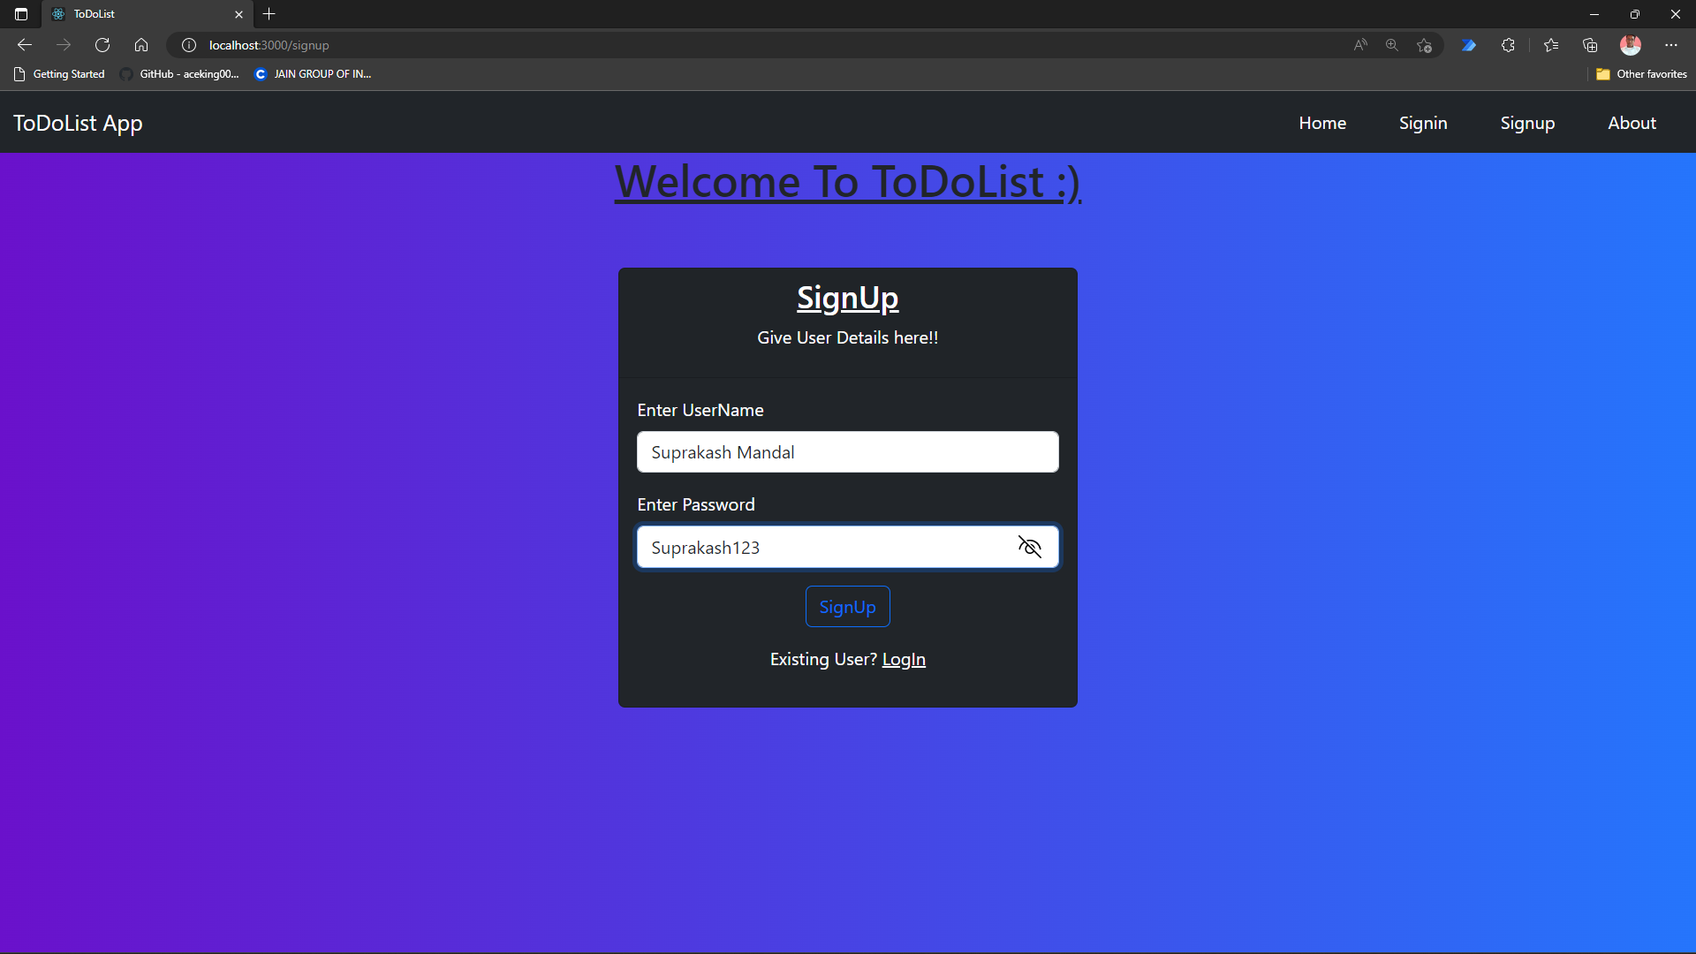
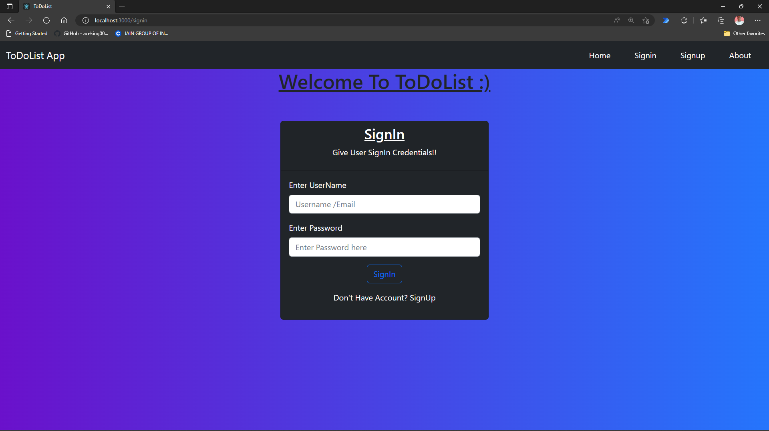
Sign Up Page & Sign In Page

Slide 14
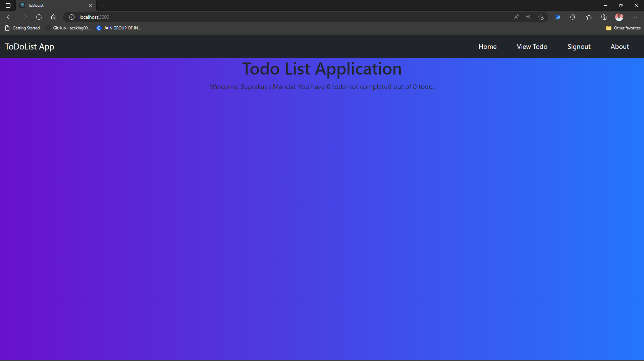
Home Page

Slide 15
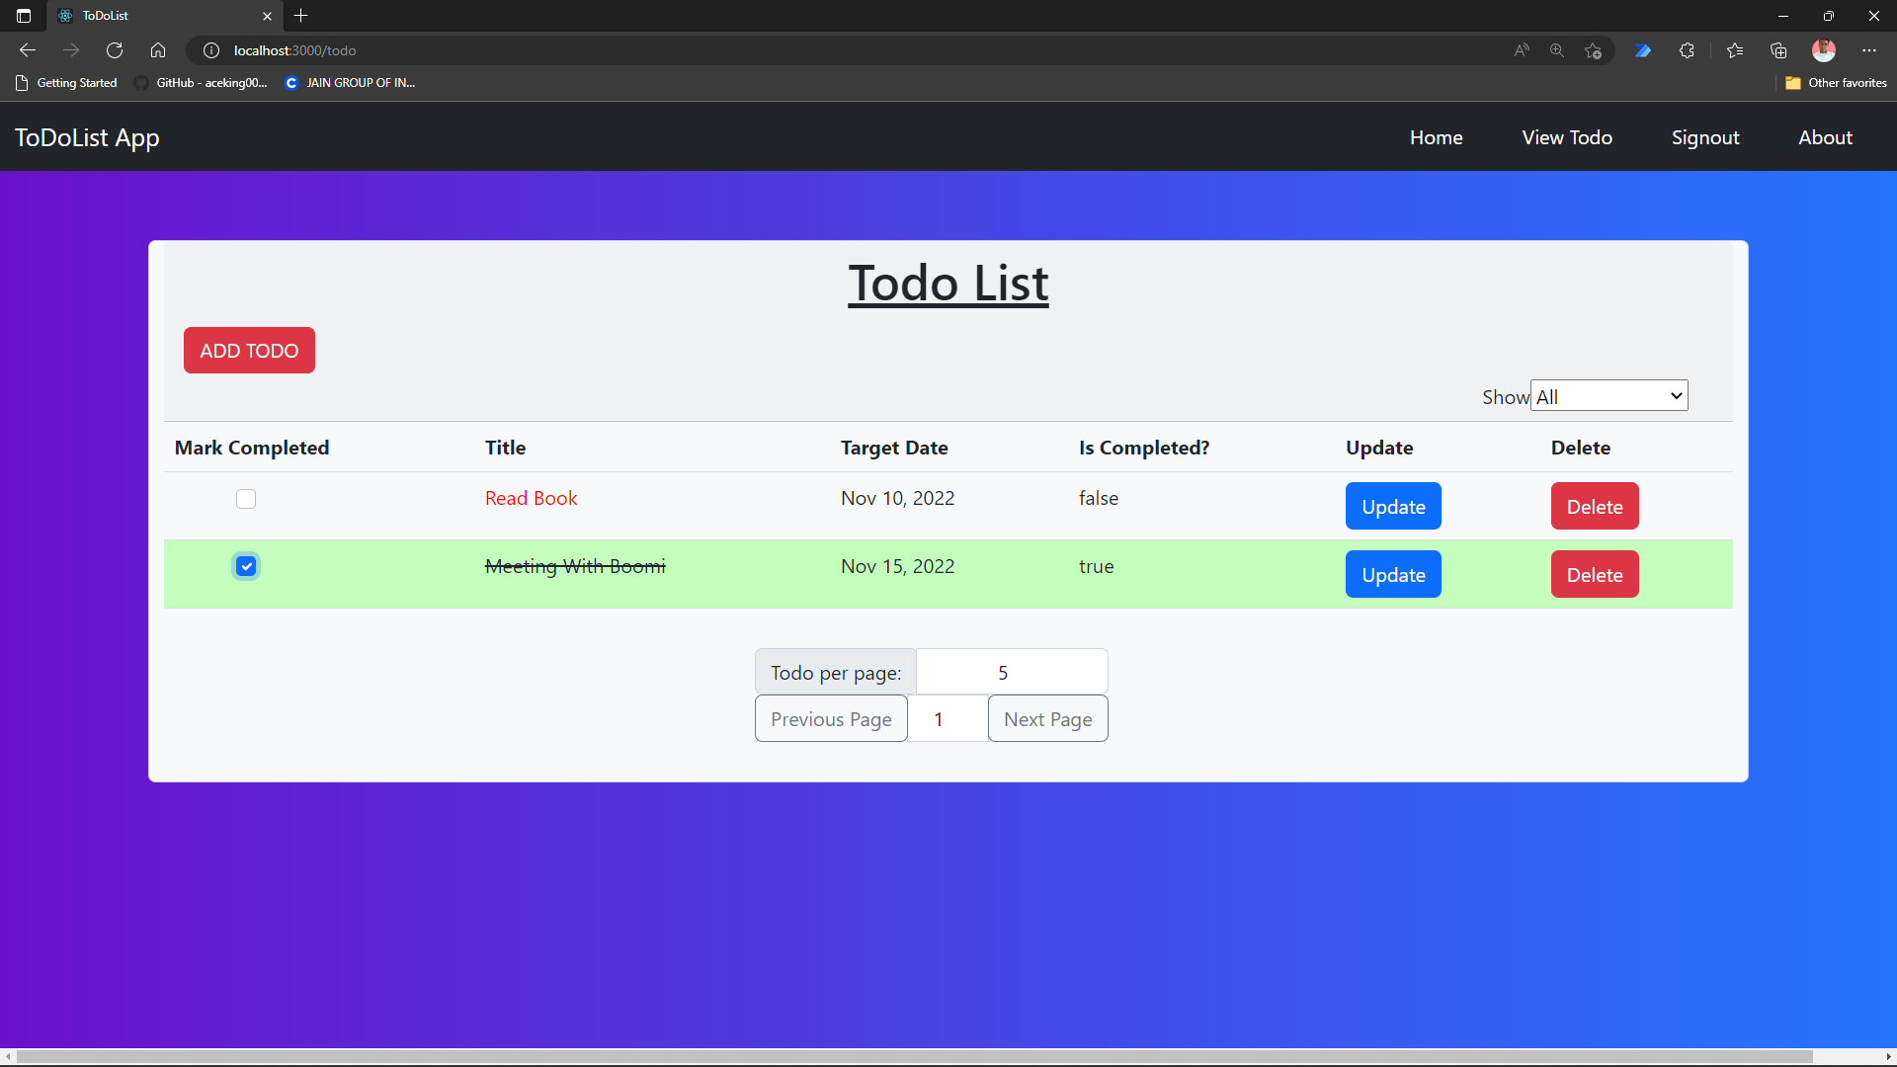
View To-do

Slide 16
Reflection Notes
This project helped us in understanding tools like bootstrap ,postman ,Mysql ,react.
We faced issues in date formatting and also doing authorization was hard.
Constant interaction among our team members helped us to sharpen our technical skills ,but also enhanced my speaking and communication abilities.

Slide 17


